Slide 1


Instruction format & example of assembly language(MIPS ISA)

Slide 2
Overview
Instruction format (PDP)
Contoh Bahasa assembly (MIPS ISA)

Slide 3

Instruction Formats
Instruction format mendefinisikan layout dari bit pada sebuah instruksi
Instruction format harus meliputi:
Includes opcode
Includes (implicit or explicit) operand(s)
Addressing mode (implicit/explicit)
Lebih dari satu instruction format pada sebuah instruction set
Beberapa aspek:
Instruction length
Allocation of bits

Slide 4
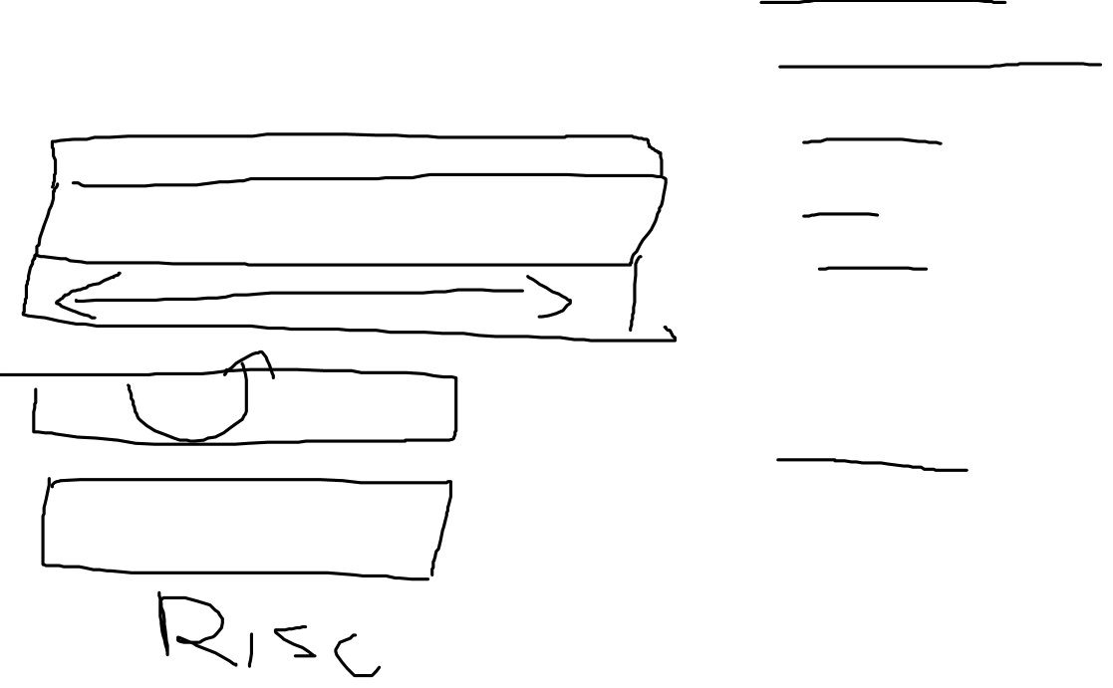
Instruction Length
Dipengaruhi dan mempengaruhi
Memory size
Memory organization
Bus structure
CPU complexity
CPU speed
Trade off antara powerful instruction repertoire and saving space
Programmer: ingin instruksi panjang agar powerful

Slide 5
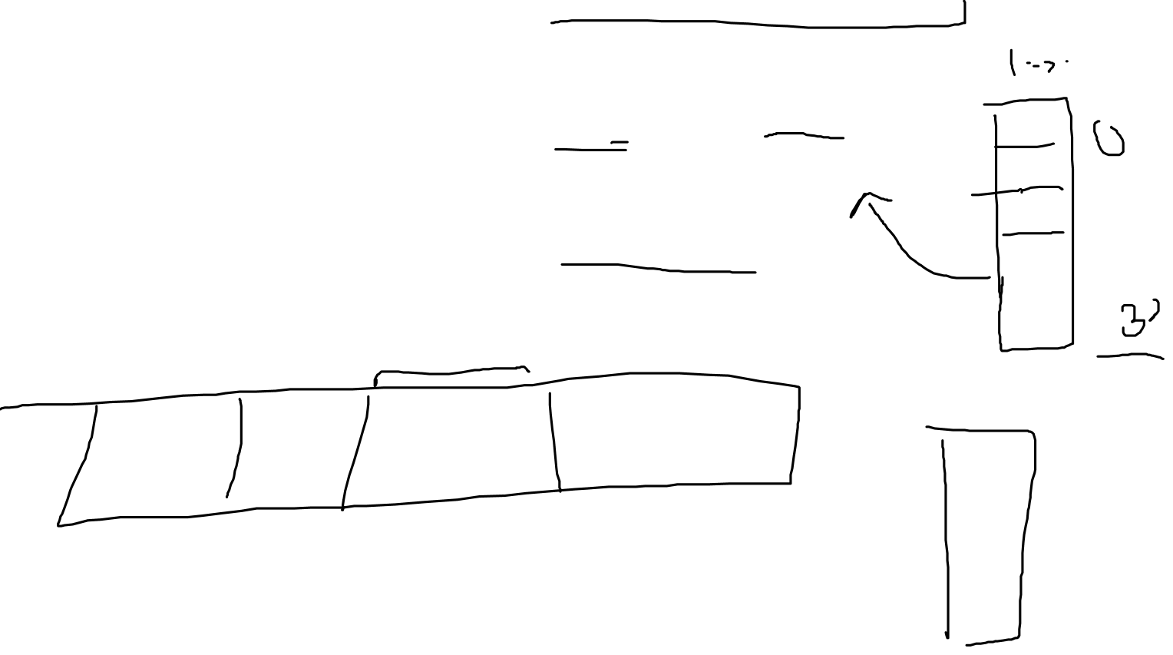
Allocation of Bits
Number of addressing modes
Number of operands
Register versus memory
Number of register sets
Address range
Address granularity

Slide 6
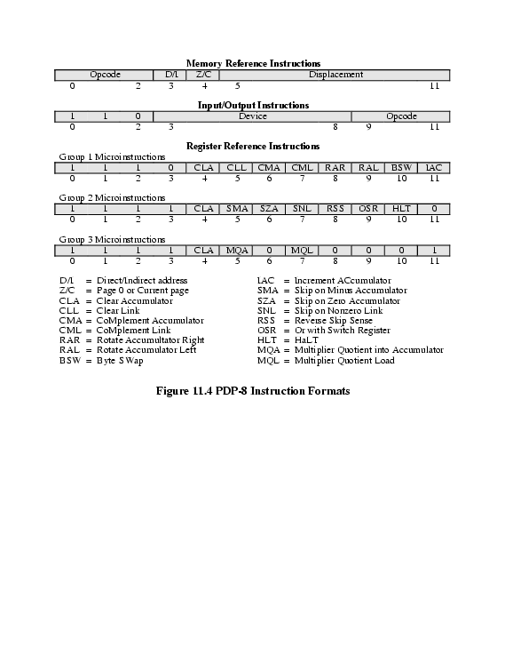

PDP-8 Instruction Format

Slide 7
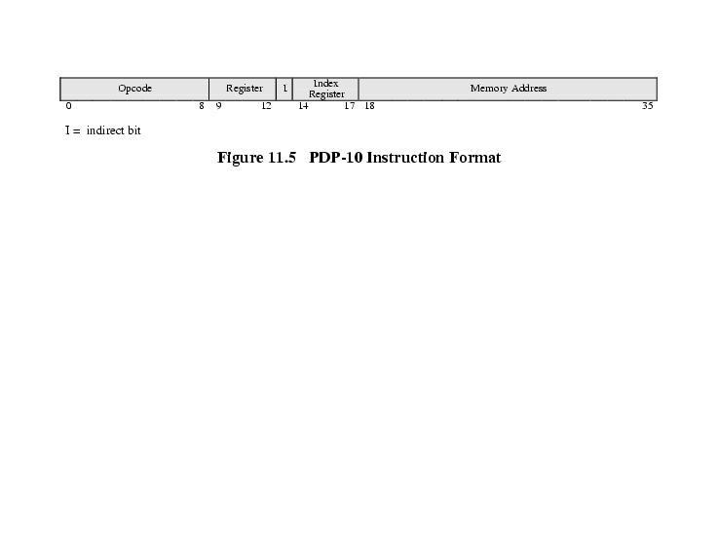
PDP-10 Instruction Format

Slide 8
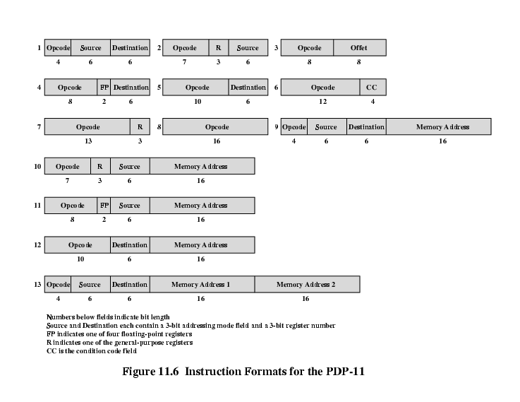
PDP-11 Instruction Format

Slide 9
MIPS

Slide 10
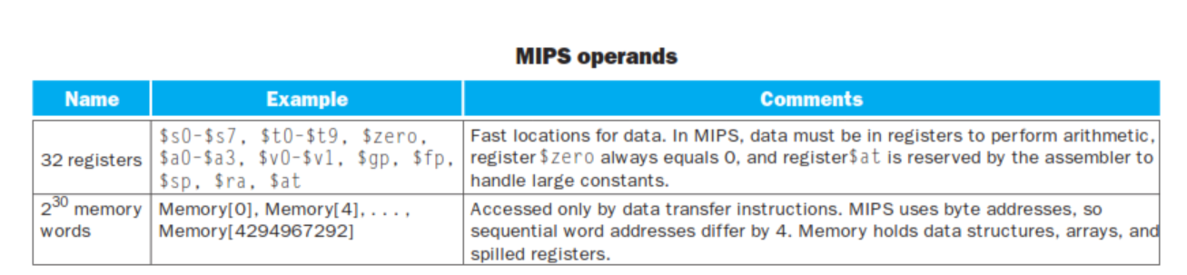
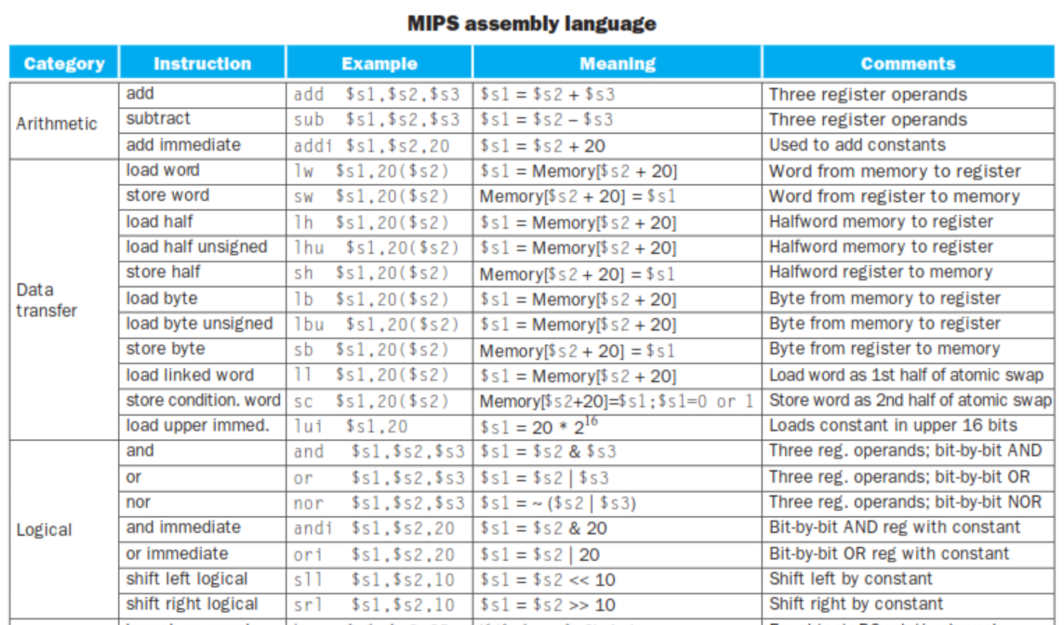


Slide 11
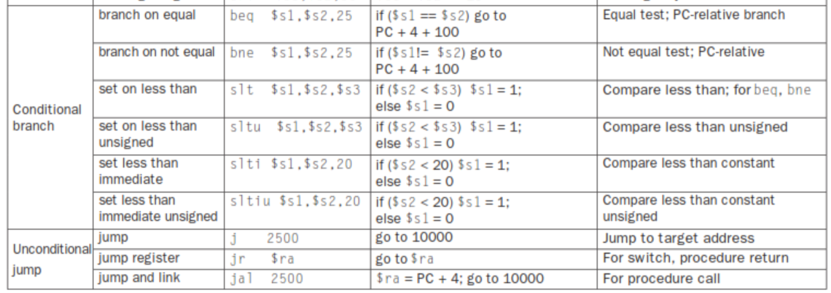


Slide 12
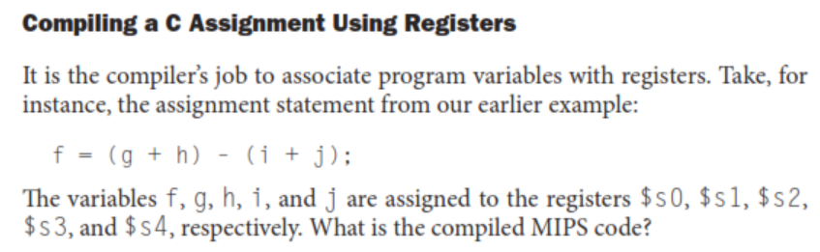
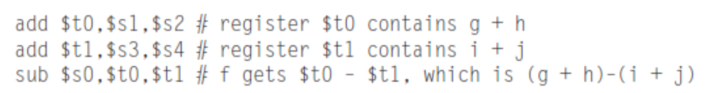


Slide 13
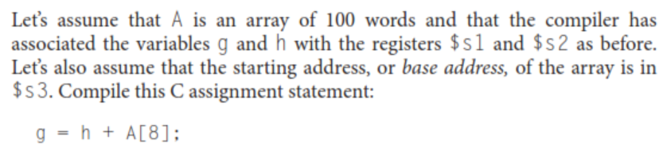
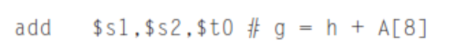


Slide 14
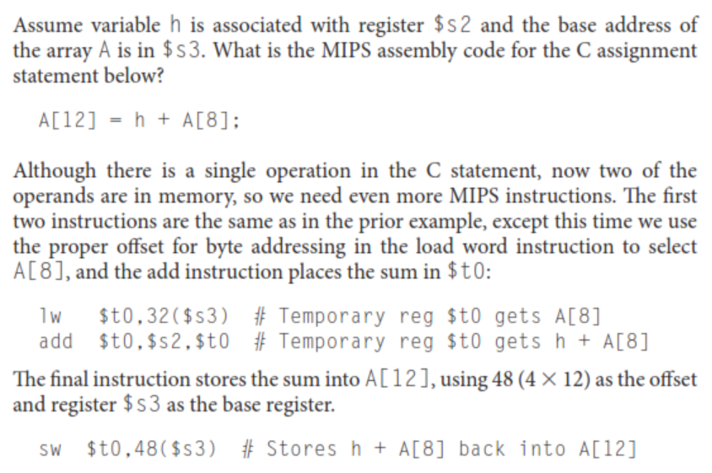
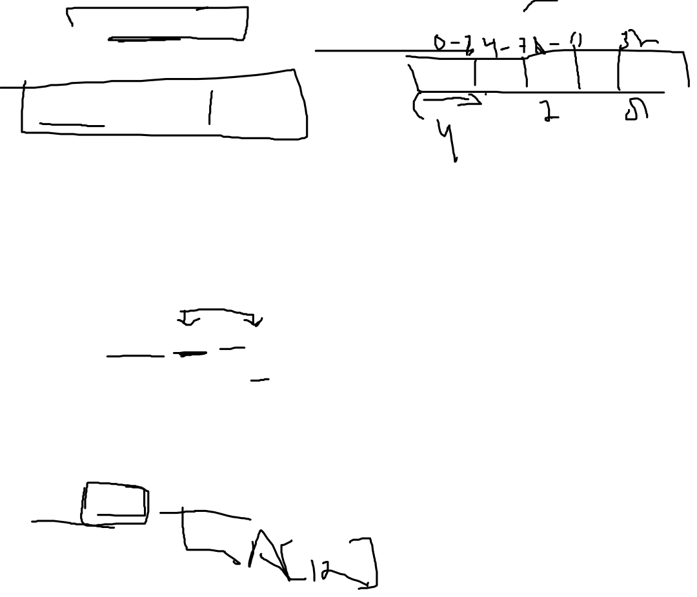

Slide 15
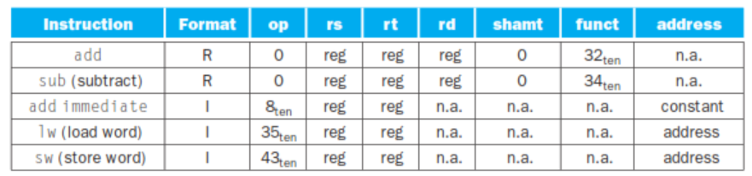
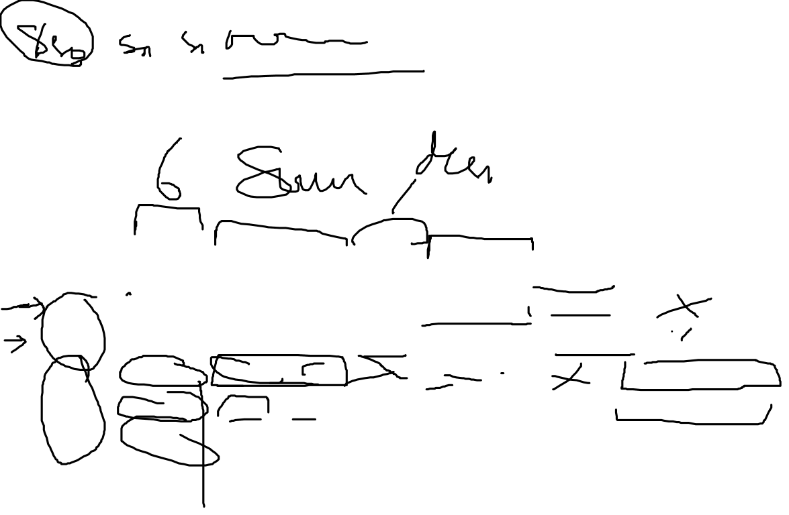

Slide 16
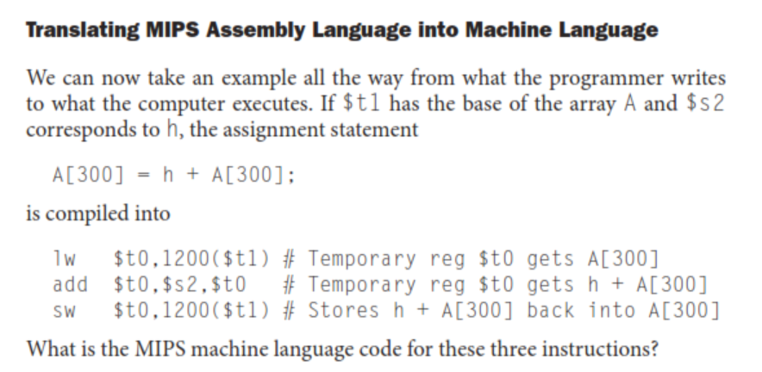


Slide 17
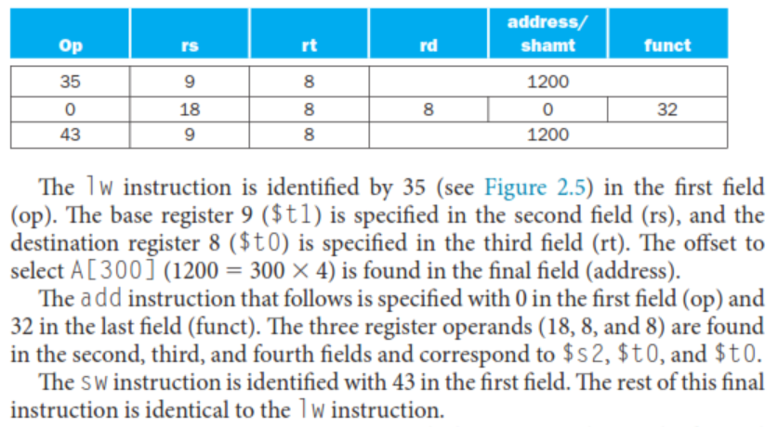
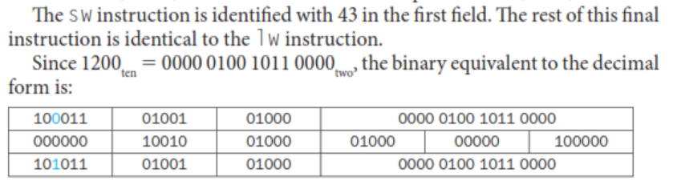
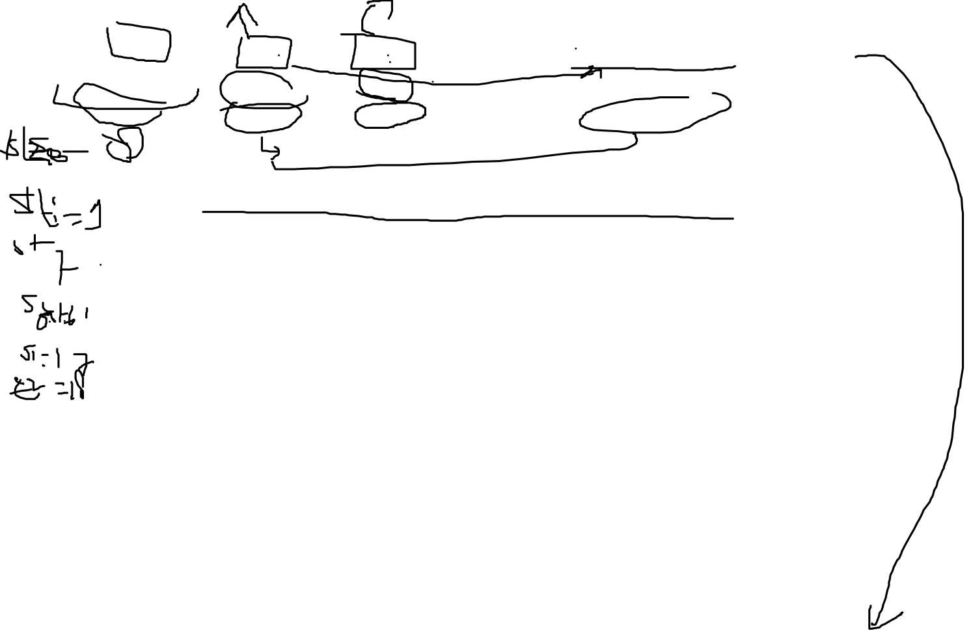

Slide 18
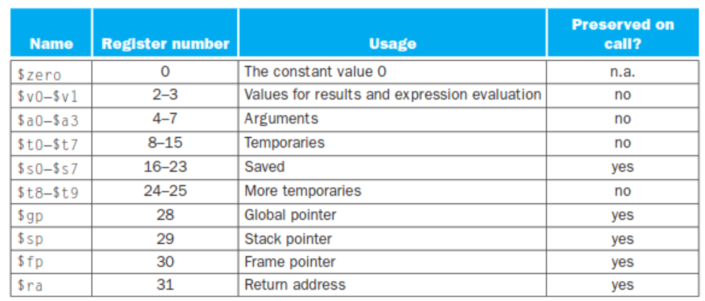


Slide 19
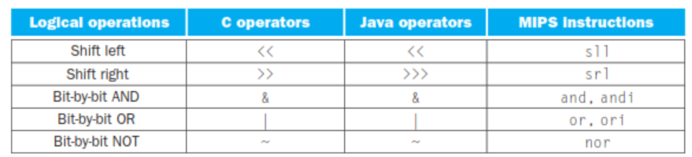
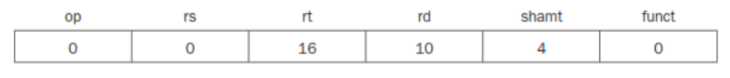
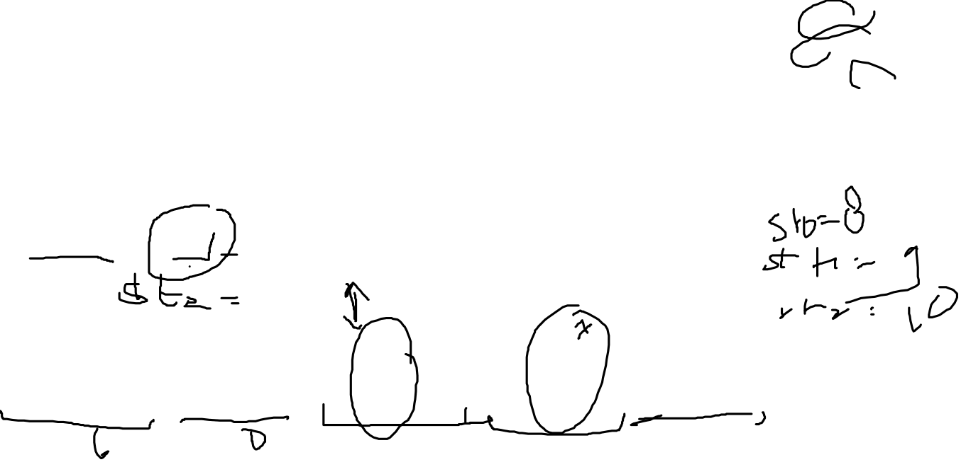

Slide 20
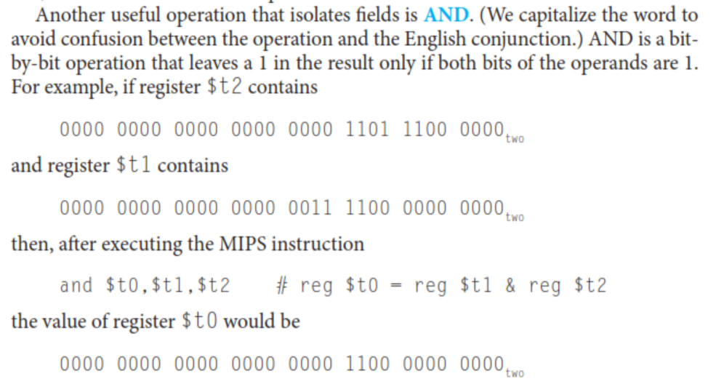


Slide 21
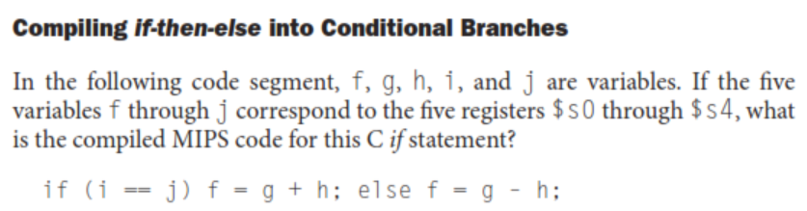
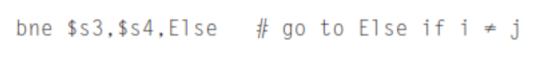
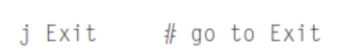
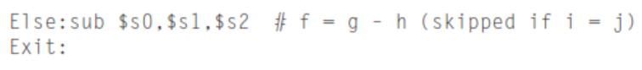


Slide 22
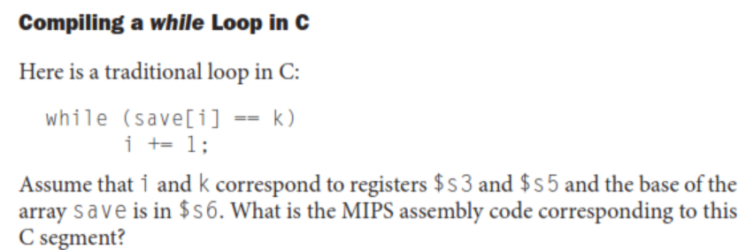
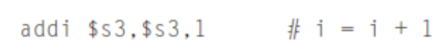
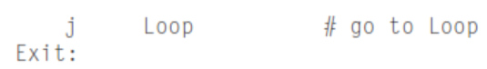
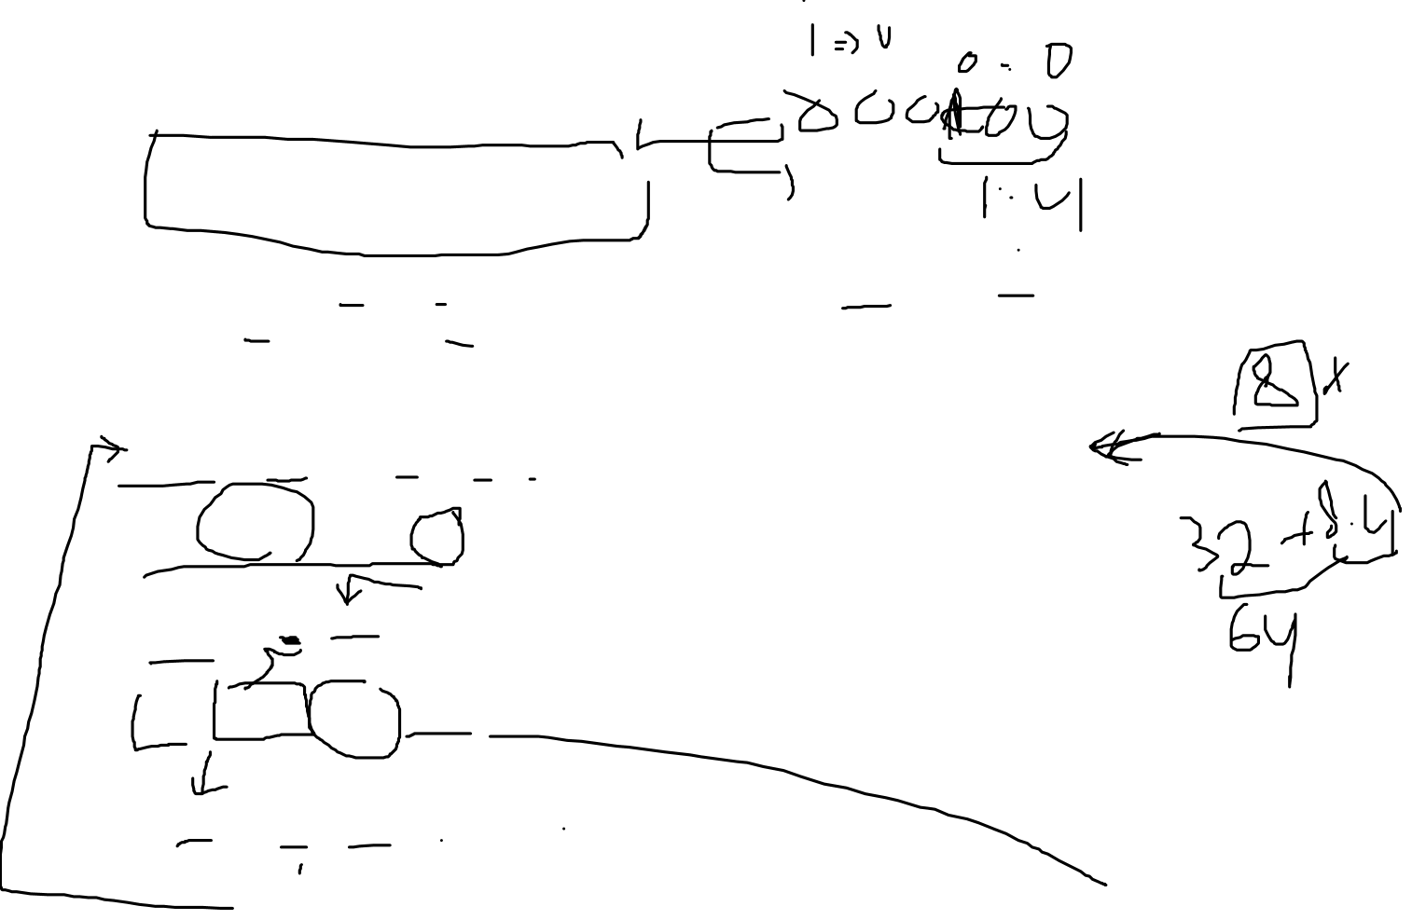

Slide 23
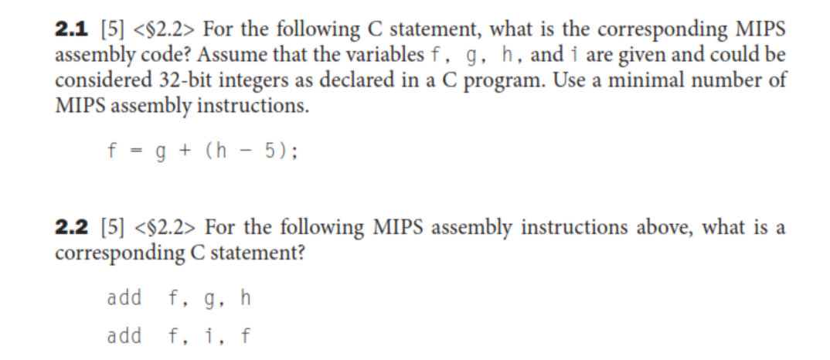

Slide 24
